Slide 1
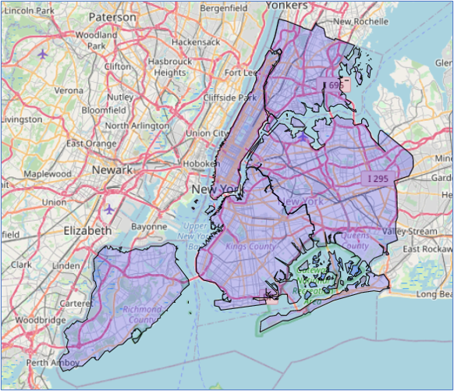
Battle of the Neighborhoods
Capstone Project by Omer Ihsan
July 7th, 2020

Slide 2
Background
A recent study has revealed that the success of a business can be determined even before a business has started its operations. A major determinant of business success is the selection of the location. A business needs to decide on the best location taking into account factors such as:
Customers
Staff
Support services
Cost
Infrastructure and Economy of Scale
Logistics
Government Facilitation
Resource

Slide 3
Business Problem & Interest
Currently an aspiring business must undertake an extensive, time consuming and exhausting practice to decide on a location to start the operations. Many a times, the exercise is not undertaken seriously because of the effort involved. The result is a business, which has a promising product but due to a bad selection of site operations, the business fails.
The aim of this project is to address the issue of selection of the best location for starting a cafeteria business and reduce the time and effort that is put in addressing this issue.

Slide 4
Data Acquisition and Wrangling
Data Sources
New York City Population by Borough, 1950 – 2040
https://data.cityofnewyork.us/resource/xywu-7bv9.csv
Per Capita Income
https://www.baruch.cuny.edu/nycdata/income-taxes/per_cap.htm
Property Valuation and Affordability
https://www.bloomberg.com/graphics/property-prices/nyc/
New York City Cafes Data
https://foursquare.com/explore?mode=url&near=New%20York%2C%20NY%2C%20United%20States&nearGeoId=72057594043056517&q=Food

Slide 5
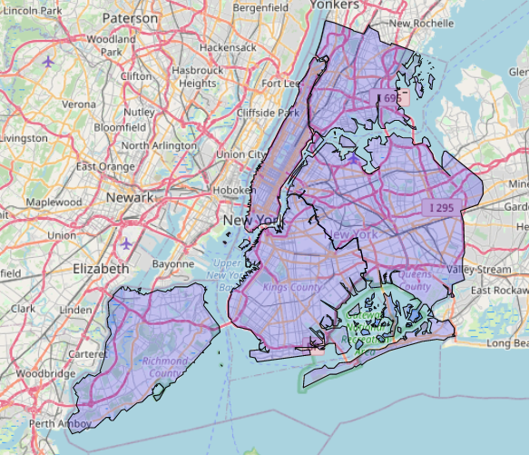
New York City Boroughs
New York City has a total of 5 Boroughs
Queens
Bronx
Manhattan
Brooklyn
Staten Island
There are 306 Neighborhoods in these 5 Boroughs

Slide 6
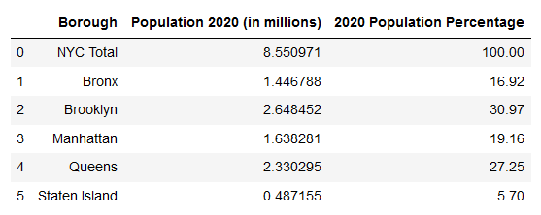
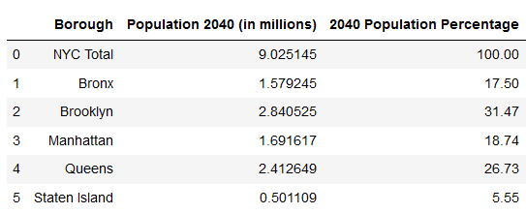
New York Population Data
New York population count data and the population percentage data are a good indicator to judge the consumer density. The larger the population count, more the consumers for any business.
We have the current population of NYC along with the prediction of the population in 2040.

Slide 7
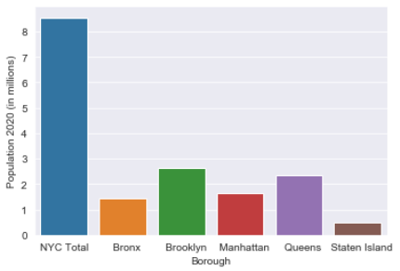
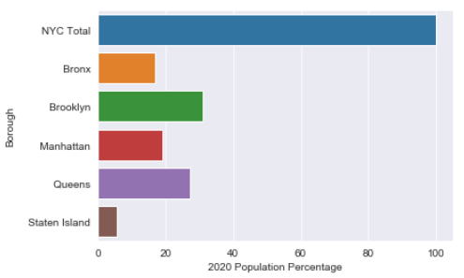
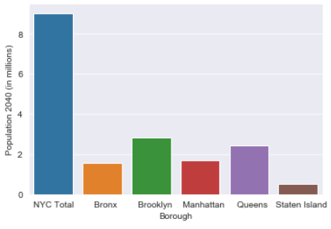
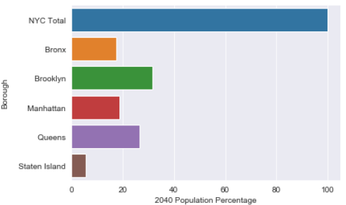
EDA : New York Population Data

Slide 8
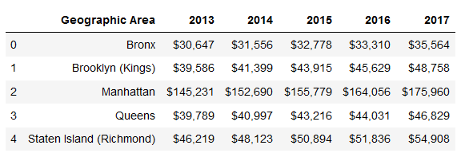
New York Per Capita Income
The data provides values for Per Capita Income for different Geographical Areas \ Boroughs of NYC. The Per Capita Income of the Area is proportional to the spending power of the residents. A greater value of PCI indicates a greater spending power.

Slide 9
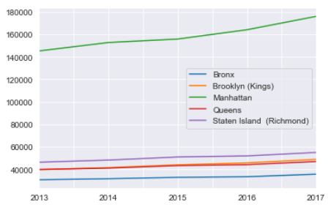
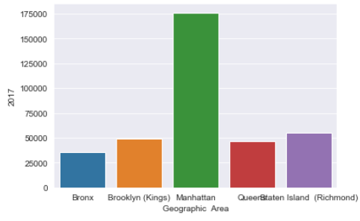
EDA : New York Per Capita Income

Slide 10
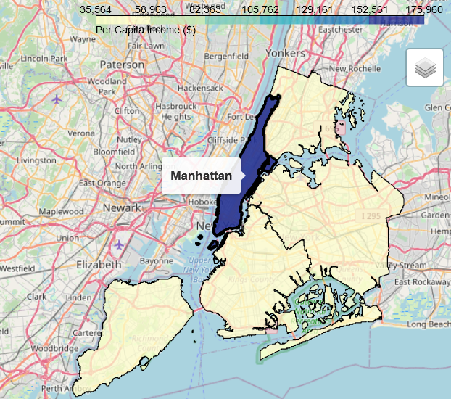
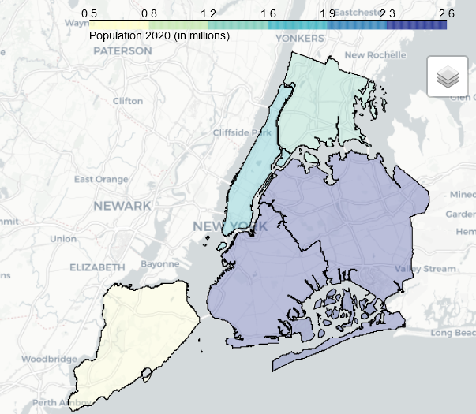
Choropleth Maps
Manhattan Per Capita Income
Manhattan Population 2020 (in millions)

Slide 11
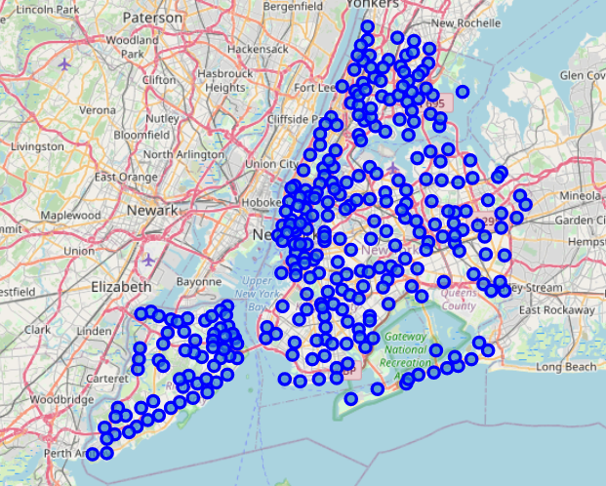
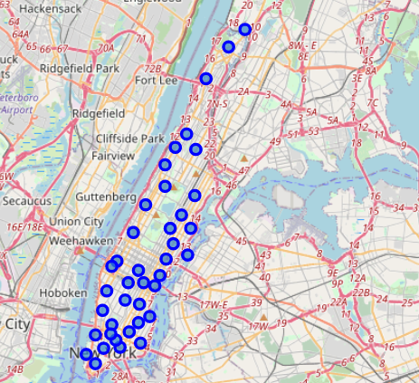
New York Neighborhoods
New York City Neighborhoods
Manhattan Neighborhoods

Slide 12
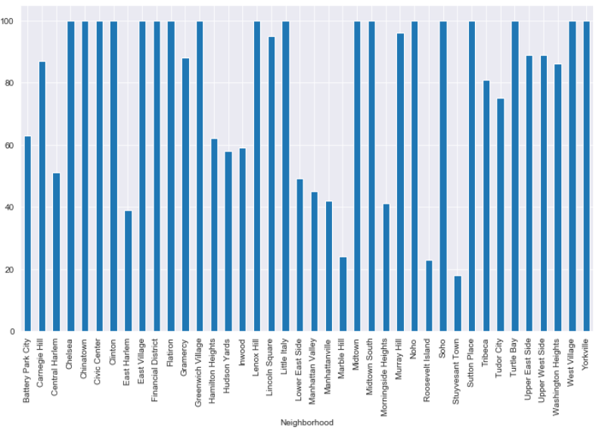
Venue Categories : New York Neighborhoods
These are the Venue Categories returned by the Foursquare APIs in a 500m radius of each NY Neighborhood

Slide 13
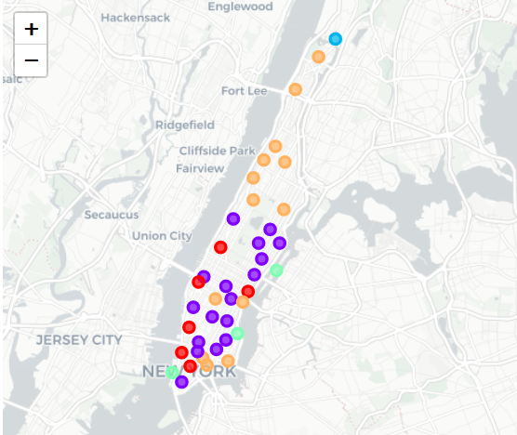
Data Clustering
K Means Clustering
K-Means Clustering is an unsupervised learning algorithm that tries to cluster data based on their similarity. Unsupervised learning means that there is no outcome to be predicted, and the algorithm just tries to find patterns in the data.
We will use Clusters = 5 to segment the data in to 5 sets of Manhattan neighborhoods. The neighborhoods will be grouped based on the similarities of the venue categories returned by the Foursquare API.

Slide 14
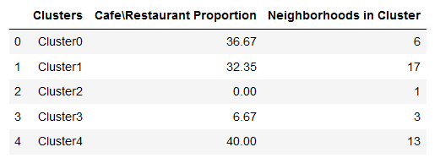

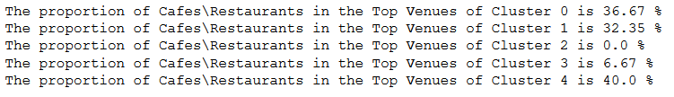
Clustering Results

Slide 15
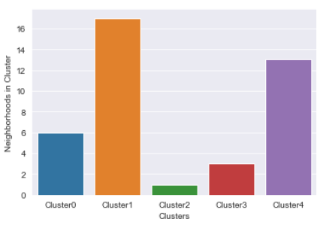
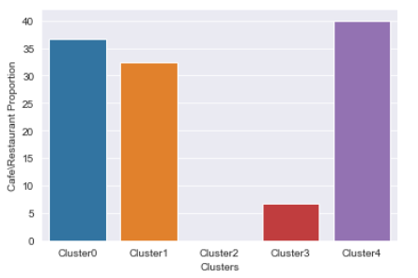
EDA : Cluster Data

Slide 16
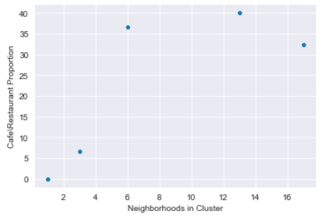
Conclusion
Parameters such as consumer density, spending power and competition are extremely important in deciding for a location to start any business. Anyhow they are not the only parameters. This study provided these parameters to potential investors who wanted to start a café\restaurant in New York.
Based on the analysis for consumer density and spending power of the people of New York, we were able to select Manhattan as the potential borough to start the café.
We have finalized to suggest to our investor to go for an investment in Cluster 1 mainly because of two reasons
Number of neighborhoods in the cluster is the highest which suggests a larger area and bigger number of consumers.
Secondly, the proportion being lower than the highest proportion of 40% suggests that there is room for competition.

